Slide 1
Inventory Manager
Simple, Fast, and Reliable Inventory Tracking.
Team 2 Project

Slide 2
The Goal
The goal of this project is to build a lightweight, open-source inventory tracker that businesses can deploy to manage their warehouse stock efficiently.
Specifically, the system allows companies to:
Manage Warehouse Stock:
Easily add, edit, and delete inventory items, categorize them properly, and maintain a real-time overview of current stock levels through a clean user interface.
Track Changes Over Time:
Maintain a historical record of quantity changes for each item. By visualizing stock fluctuations with graphs, managers can better understand inventory trends and identify patterns over time.
Notify Managers When Inventory is Low:
Set up an automated notification system that alerts managers immediately when an item’s quantity reaches zero. This ensures critical items are reordered on time, minimizing disruption to business operations.

Slide 3
Our Project Information
Languages:
JavaScript + Node.js
MongoDB
Markdown
Tools:
Github (Main - Priyanka Pandit)
VSCode
Notion
Chart.js
EmailJS
Communication:
Email
Teams
Discord
Team Rules
No Surprise Rule
Communication Expectations
Peer Review Penalty
Respect Deadlines
Be Supportive

Slide 4
Module Overview
Secure Login
Add Items
Edit and Delete Items
View Stock and Search
Stock Graphs
Import CSV
Export CSV
Low Stock Notifications
History Tracker
Inventory Dashboard Insights
Item Popularity Tracker

Slide 5
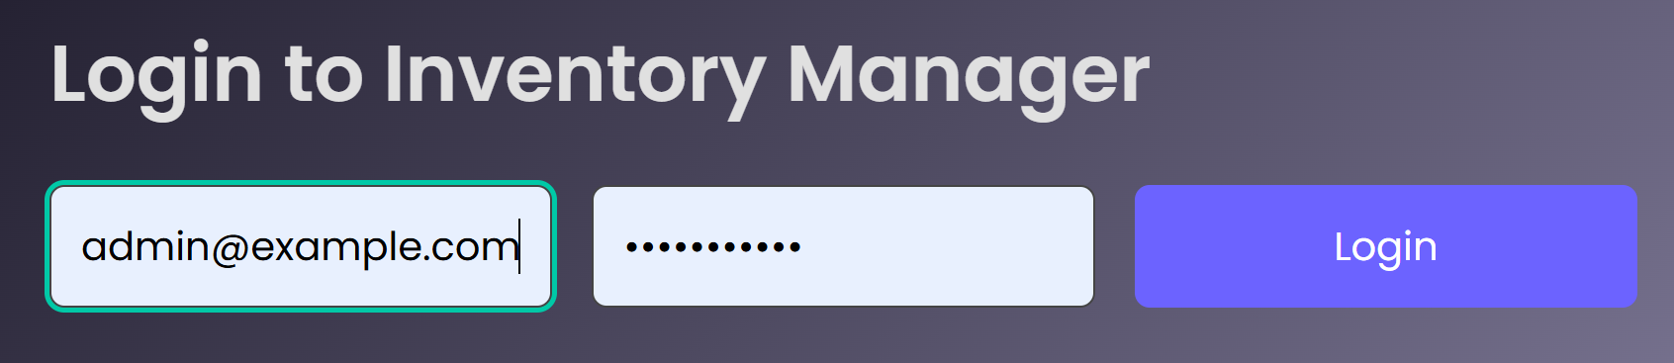
Preston’s Module: Secure Login
Managers log in securely using email and password.
Prevents unauthorized access to inventory data.

Slide 6
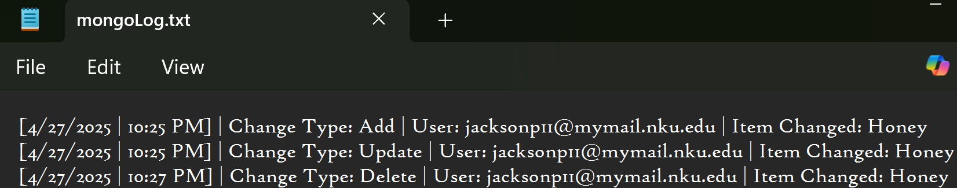
Preston’s Module: History Tracker
All inventory changes are logged:
Records who made changes
Records what changes were made
Supports accountability and audits

Slide 7
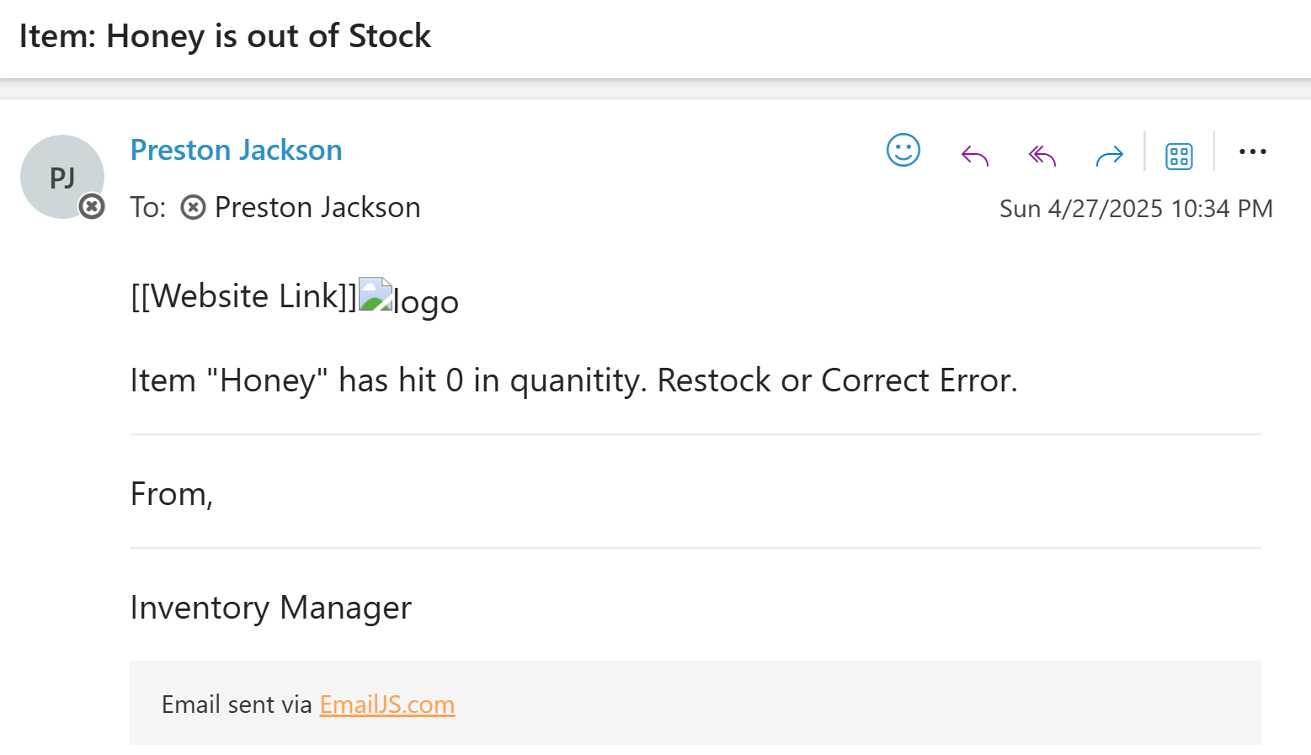
Preston’s Module: Low Stock Notifications
Automatic email alerts are sent when an item's quantity reaches zero.
Helps managers reorder stock in a timely manner.

Slide 8
Jacob’s Module: Add Items
Users can quickly add inventory items:
Name
Quantity
Price
Category
Tags for better organization

Slide 9
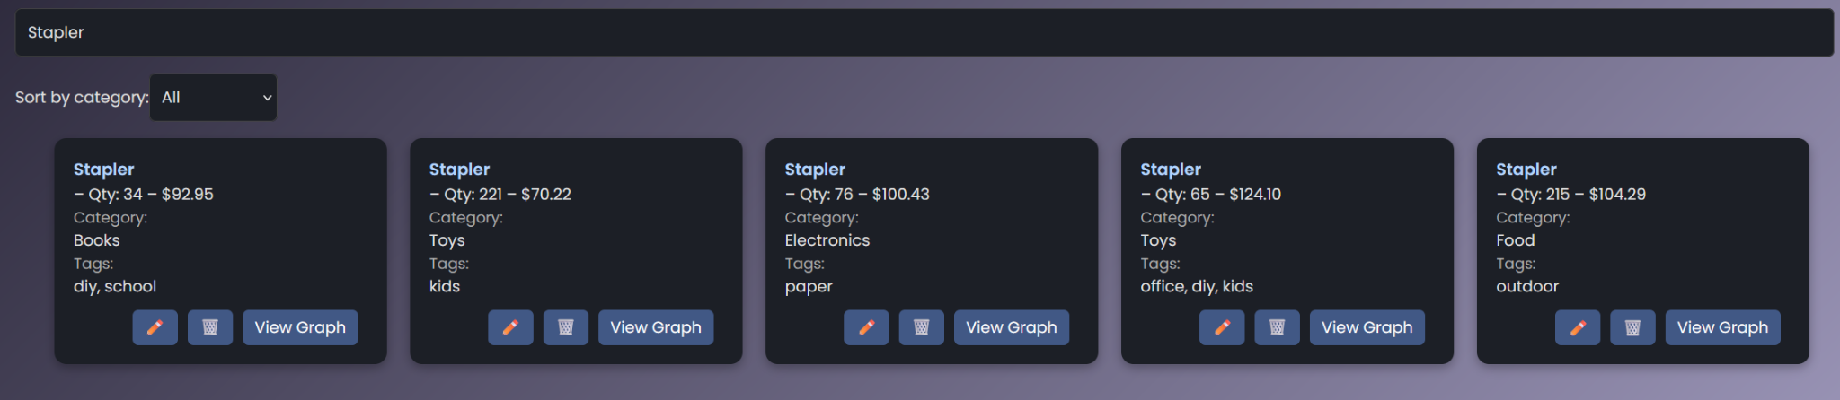
Jacob’s Module: View Stock and Search
Users can search items by:
Name
Category
Tags
Allows fast and efficient item lookup.

Slide 10
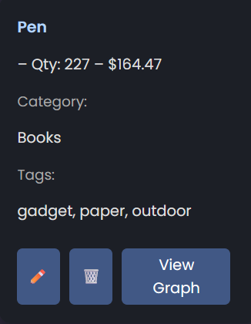
Jacob’s Module: Edit and Delete Items
Update item details like price, quantity, and category.
Delete discontinued items to maintain a clean inventory.

Slide 11
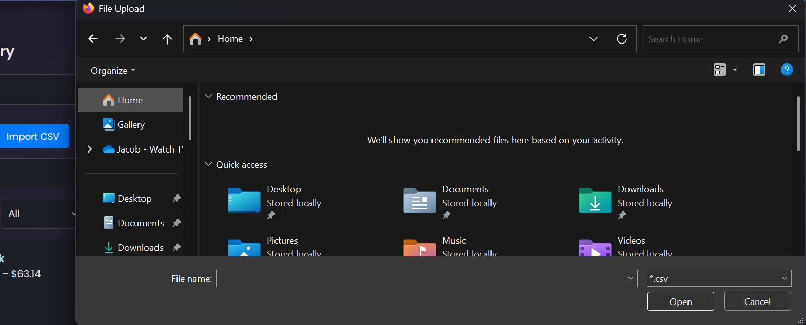
Jacob’s Module: Import CSV
Import multiple items at once:
Upload a CSV file
Bulk add inventory quickly and efficiently

Slide 12
Jacob’s Module: Export CSV
Export the inventory list to a CSV file:
Create backups
Analyze inventory data externally

Slide 13
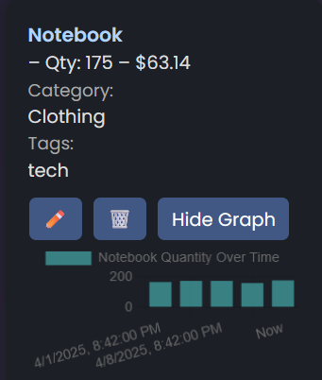
Jacob’s Module: Stock Graphs
Graphs are available under each item:
Show quantity changes over time
Provide a visual understanding of stock trends

Slide 14
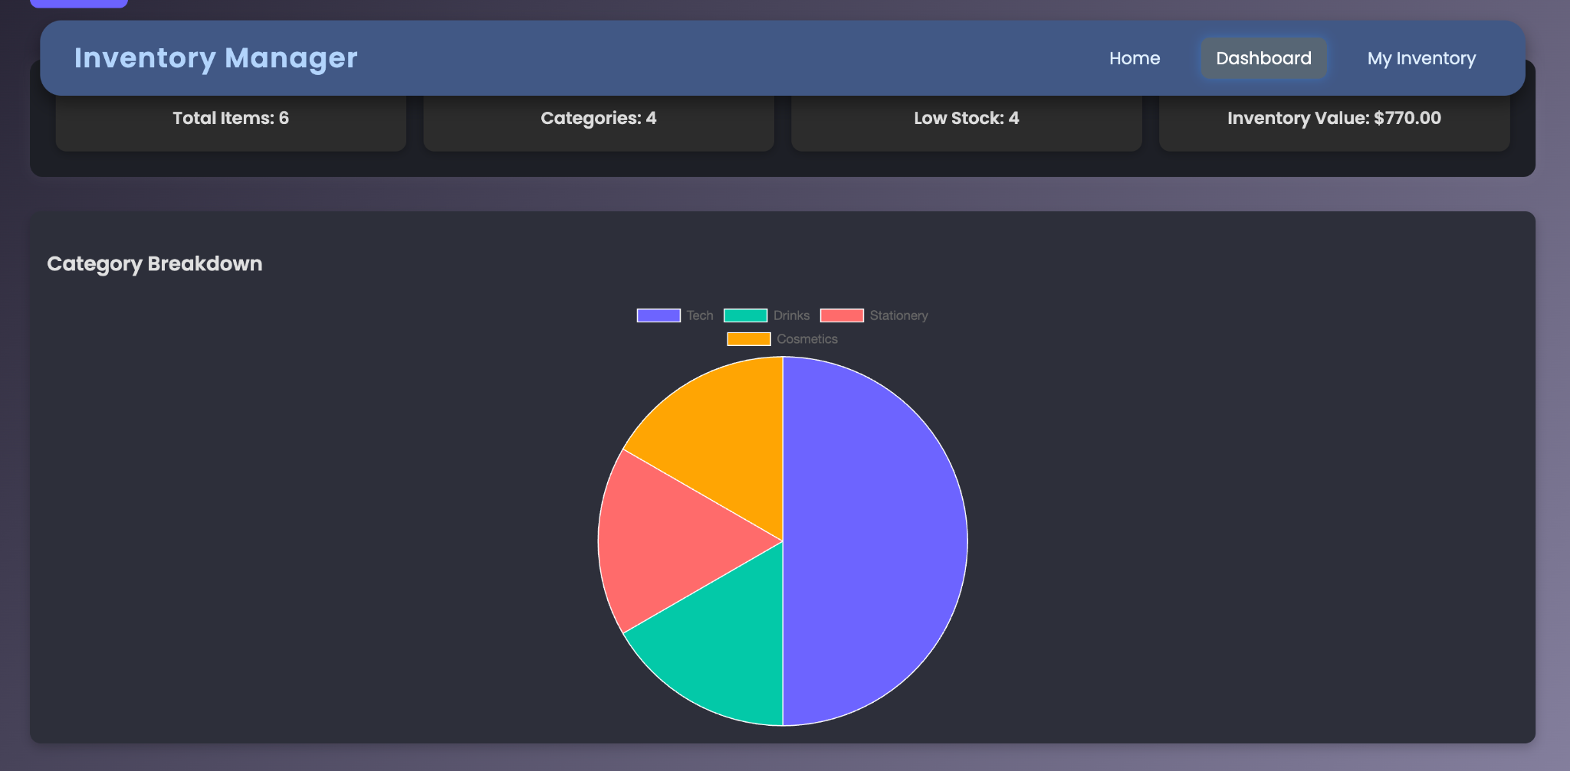
Priyanka’s Module: Category Breakdown Chart
Displays a pie-chart of all inventory categories.
Dynamically updates as items are needed.
Gives users a visual breakdown of where most inventory lies.
Built using “react-chartjs-2.”

Slide 15
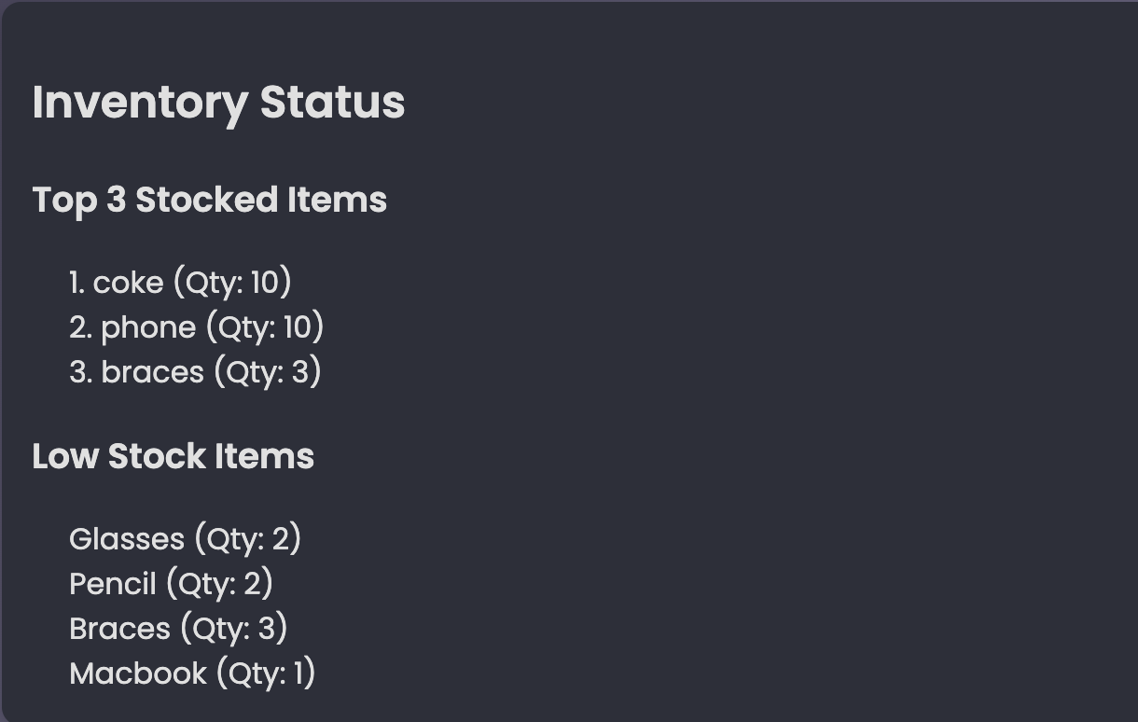
Priyanka’s Module: Inventory Dashboard Insights
Shows total item count, number of categories, inventory value, and low stock items.
Lists the top 3 stocked items (based on quantity.)
Lists items low on stock (quantity < 5).
Gives a quick glance at what needs restocking.
Helps users make fast decisions without digging through the whole list.

Slide 16
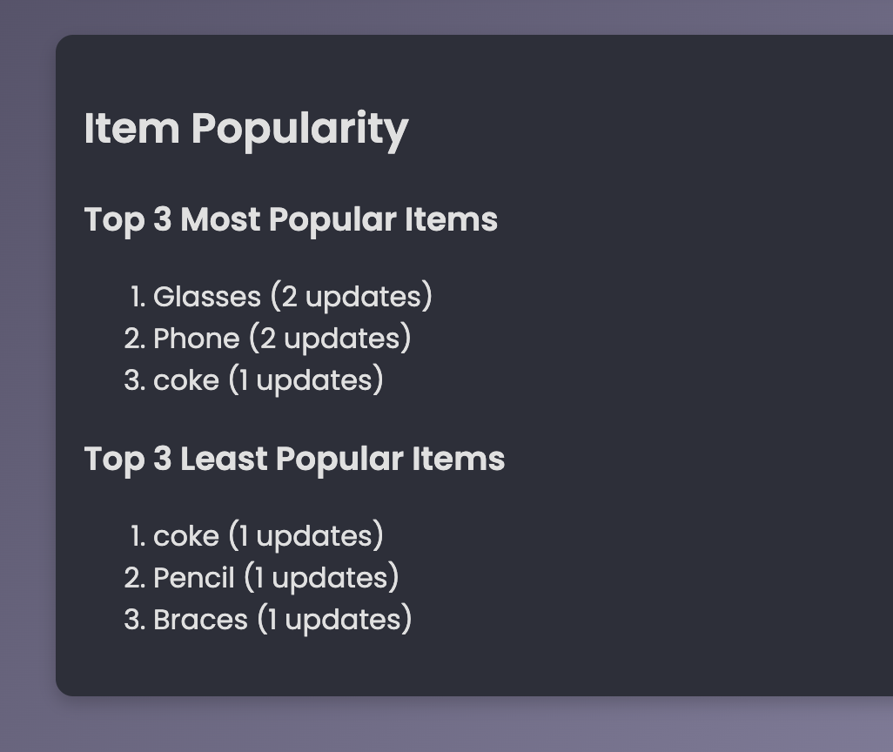
Priyanka’s Module: Item Popularity Tracker
Tracks how many time an item’s quantity was updated.
Displays the top 3 most updated (popular) and least updated (less active) items.
Helps users identify fast-moving or stagnant inventory.
Shows thoughtfulness in using backend history[] data for analytics.

Slide 17
Testing Strategies
Integration Tests
Ensure Node.js backend logic integrates with MongoDB correctly (e.g., adding a new item persists in the DB).
Regression Tests
Confirm new modules don’t break older ones (e.g., “Add Item” still works after “Update Item” logic).
Acceptance Tests
Simulate real-world scenarios (e.g., user can add, edit, delete an item successfully).

Slide 18
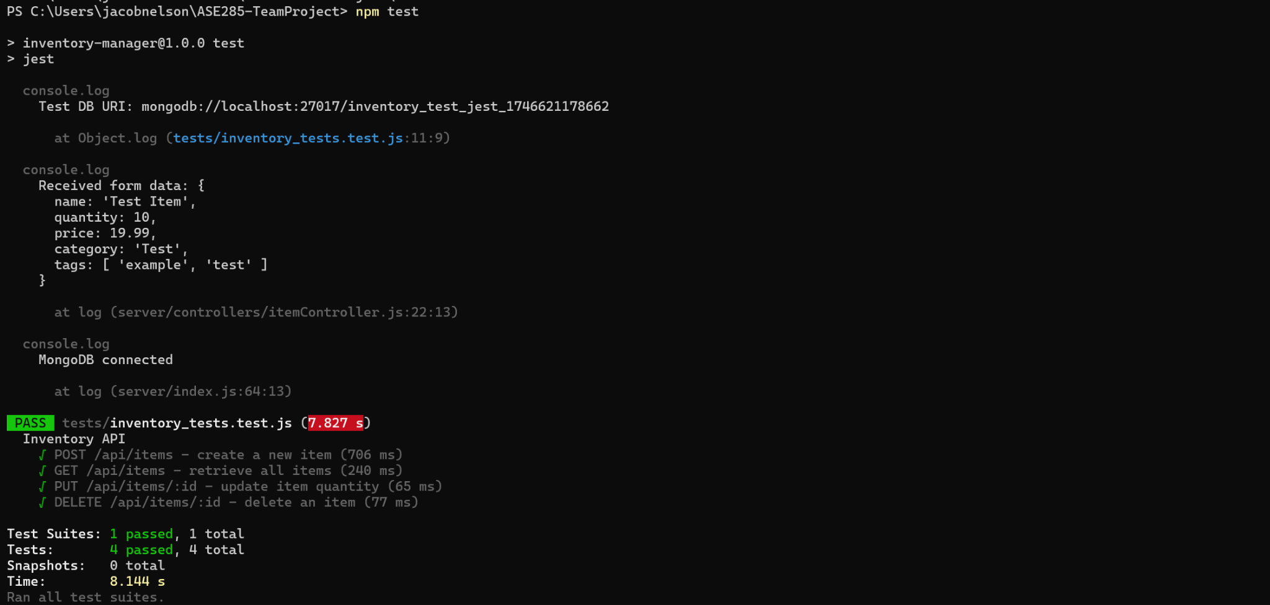
Tests

Slide 19
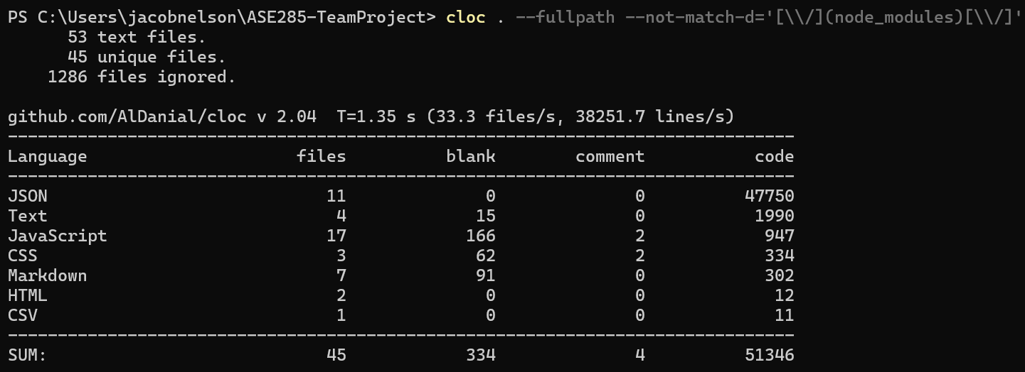
CLOC

Slide 20
Final Product
A clean, professional, easy-to-use inventory management system:
Real-time tracking
Reliable imports and exports
Secure access for managers
Clear stock trend visualization

